Slide 1


Covid-19 Support Management System
Group 7
Tarun Chitturi Ashwin Kumar RameshKumar
Krishna Ravichandran Sreepad Parigi
Trupti Raut

Slide 2
Contents
Introduction
Entity Relationship Diagram
Database implementation
Reports and Visualizations
Conclusion

Slide 3

Introduction

Slide 4
Database Purpose
The purpose of this database is to maintain the data related to healthcare facilities, basic needs and citizens data to provide the required services which are of utmost importance during the times of the Covid-19 surge.
This database captures information related to healthcare facilities like hospitals, emergency services, laboratory testing facilities, pharmacies, vaccination centers.
The database also maintains information on the basic needs like groceries and food supply.
To have easy access, the information in this database will be accessible to general public.

Slide 5
Problems Addressed
Maintain information on availability of hospital beds and oxygen facilities so that the public can directly contact the hospital to make a booking.
Track information on availability of emergency services like ambulance, quarantine centers and helpdesk services to make it easier for the public in case of emergencies.
Maintain the list of vaccination centers and Covid testing centers so that people can directly book an appointment for vaccination or Covid testing.
Maintain and update the list of daily essential services, pharmacies and food supply services so that people can opt for home delivery and prevent the spread of Covid-19 virus as far as possible.
Track the list of plasma donors and volunteers required for essential help.

Slide 6

Entity Relationship Diagram

Slide 7
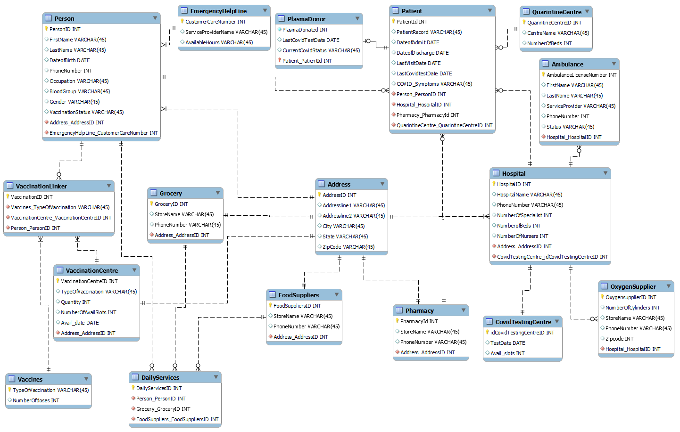

Slide 11

Database Implementation

Slide 12
Check Constraints based on a function
Type of Vaccine:
Availability of beds in a quarantine center:
Slots availability in vaccination center:

Slide 13
Hospital Phone number:
Emergency contact number:
Zip Code:

Slide 14
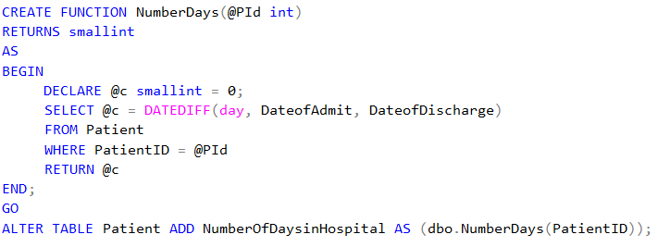
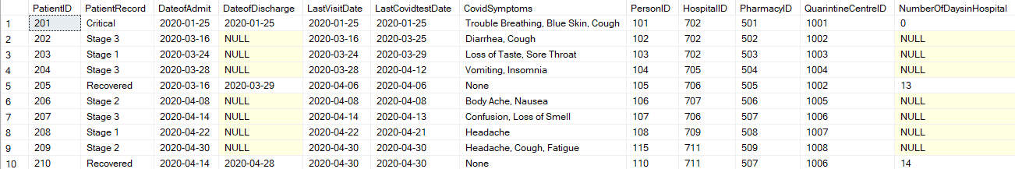
Computed columns based on a function
Number of days a patient was in the hospital:
Output:

Slide 15
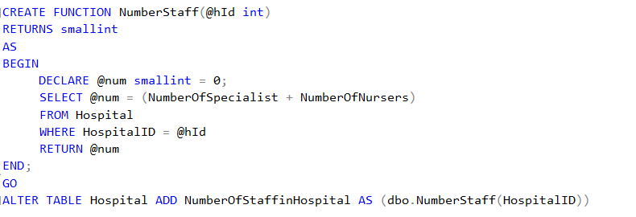
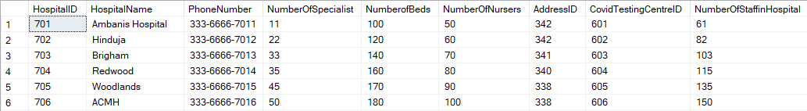
Number of staff in a hospital:
Output:

Slide 16
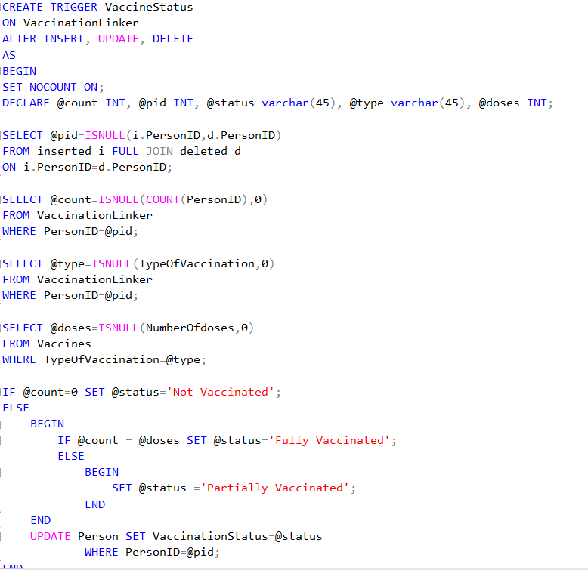
Triggers
Trigger to update the vaccination status of a person

Slide 17
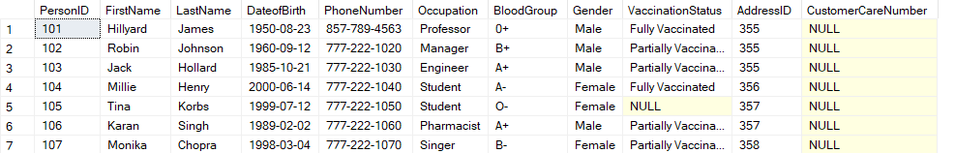
Output of first trigger

Slide 18
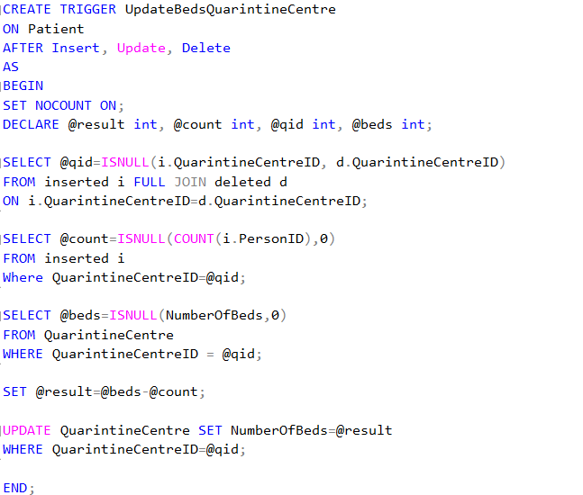
Triggers
Trigger to update the number of beds in a quarantine center

Slide 19
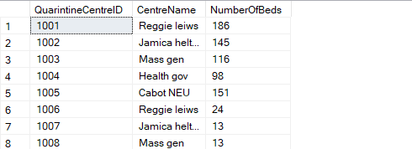
Output of second trigger

Slide 20

Reports and visualizations

Slide 21
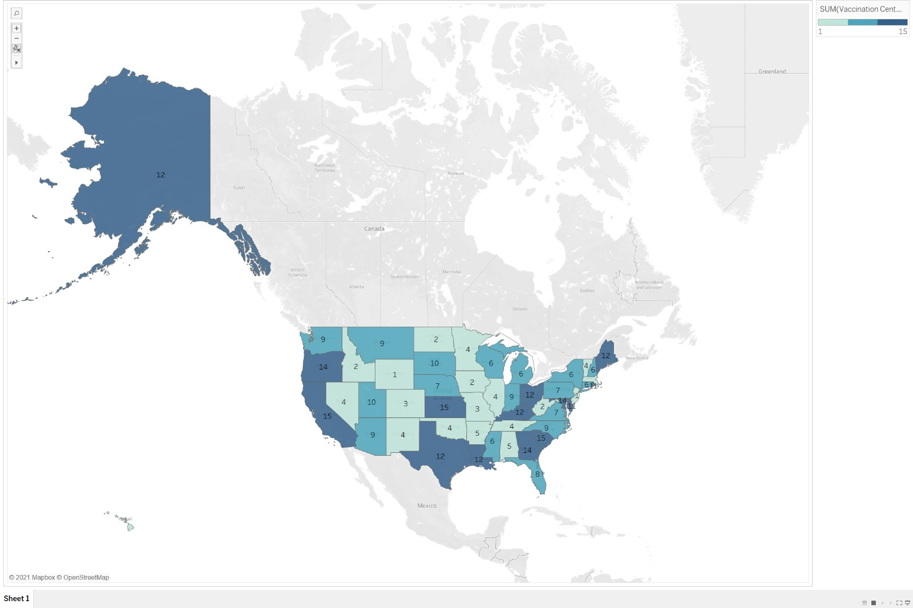
Number of Vaccination Centers in Each State

Slide 22
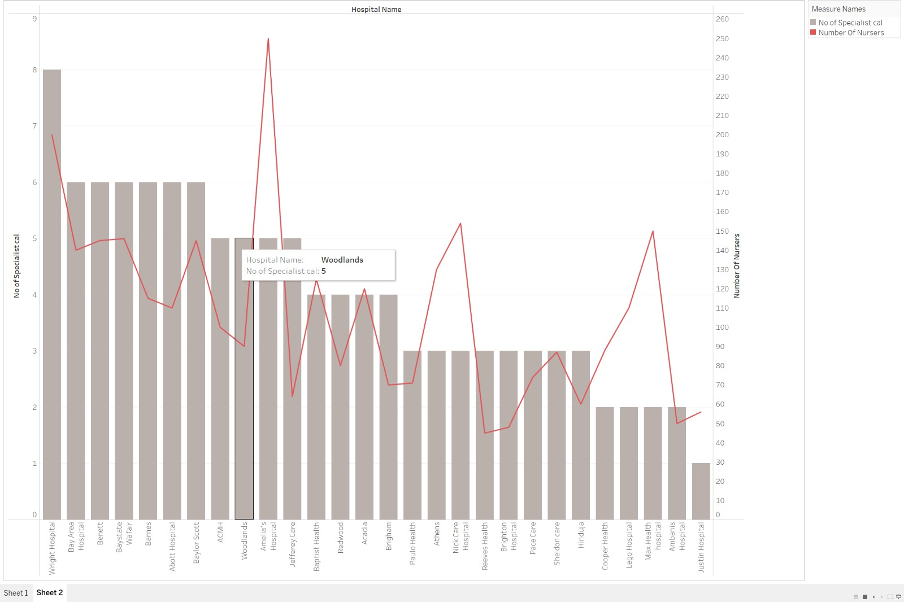
Dual Axis Graph depicting the number of specialists and number of nurses in hospitals

Slide 23
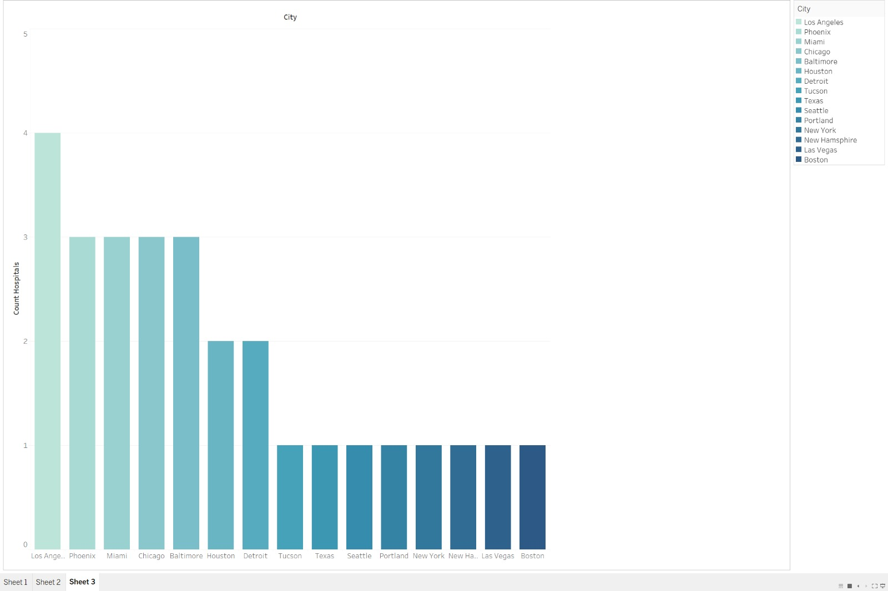
Number of hospitals in each city

Slide 24
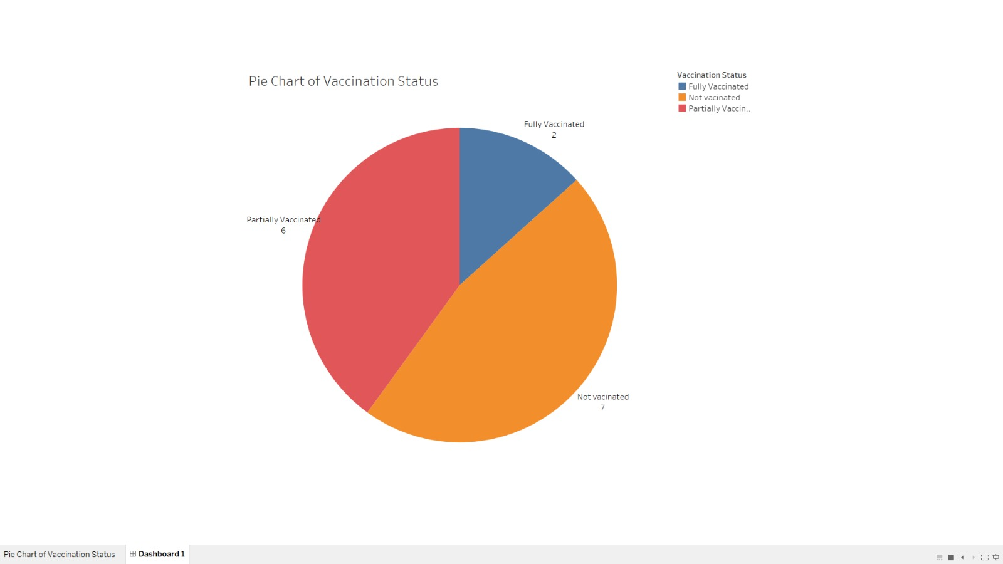
Pie Chart for Vaccination Status

Slide 25

Future Scope

Slide 26
The database can be scaled to a global level. Currently our database contains data of resources in one country. A data warehouse can be implemented which stores large amount of historical data to analyze trends and patterns in the data.

Slide 27
Thank You!

Slide 28
Q & A

